Slide 1


The Wineers

Slide 2
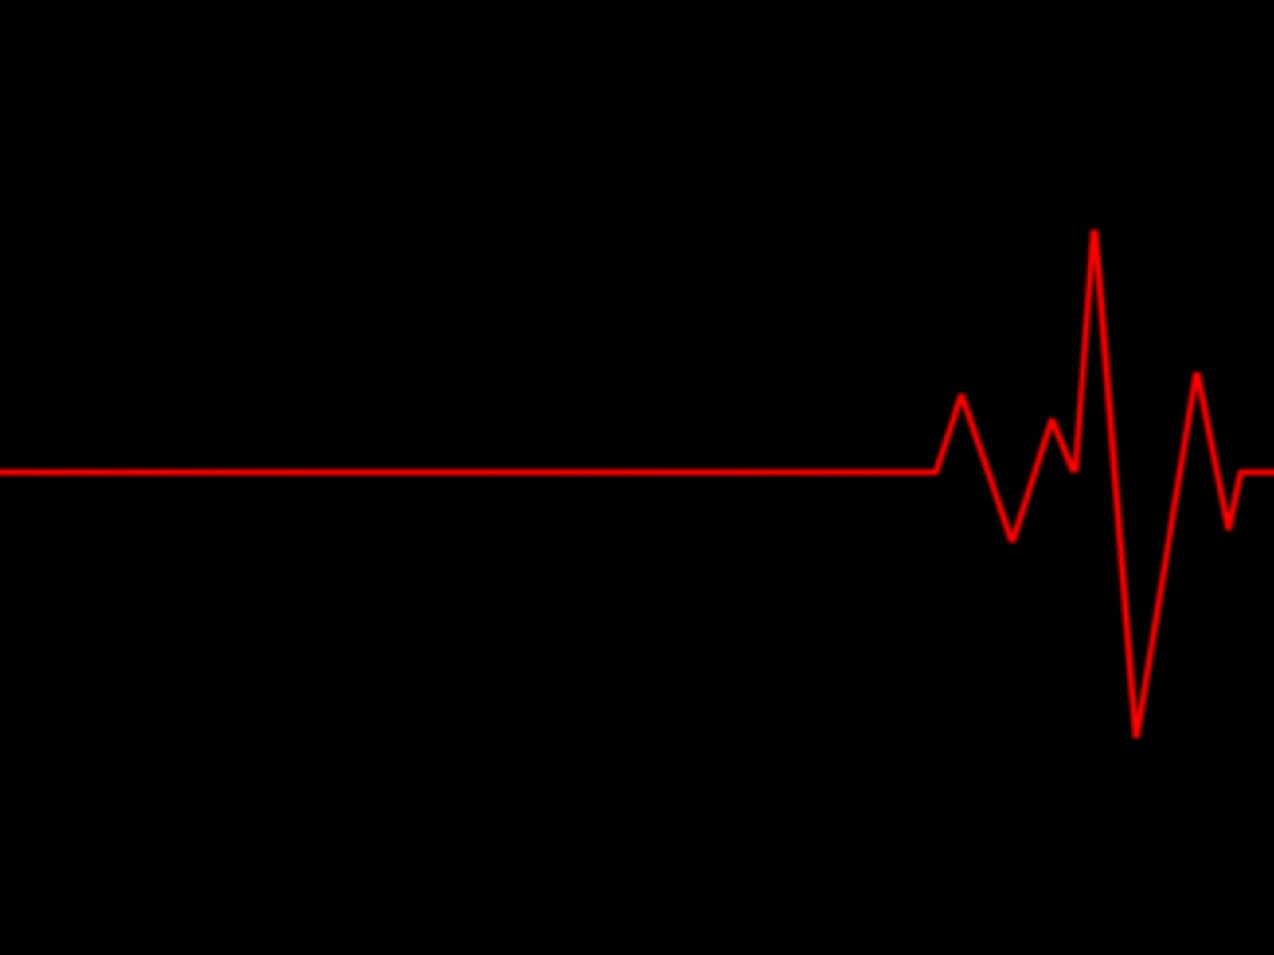

Objective

Slide 3
Objective
The goal of this technology was to advance the medical sector by simplifying patient care so they wouldn't need to visit the doctor for minor ailments.

Slide 4
Objective
For those who can't afford to see a doctor frequently, “Dr. Tech” made it more affordable. Through this product, people can consult a doctor without leaving their home to receive care.

Slide 5
Objective
Additionally, this made it easier for the doctors to assess the patient's condition and maintain track of his or her vital signs.

Slide 6


How it works

Slide 7
How it works
The ESP32 microcontroller serves as the primary brain for all functions in "Dr. Tech." The ESP32 microcontroller contains built-in wifi for data sharing. It gathers information (the patient's vital signs) from the associated modules and sends it via the Internet to the server.

Slide 8
How it works
Both the patient and the doctor can access the data from there. Based on such findings, the doctor can then provide the recommended consultation.

Slide 9

Interface

Slide 10
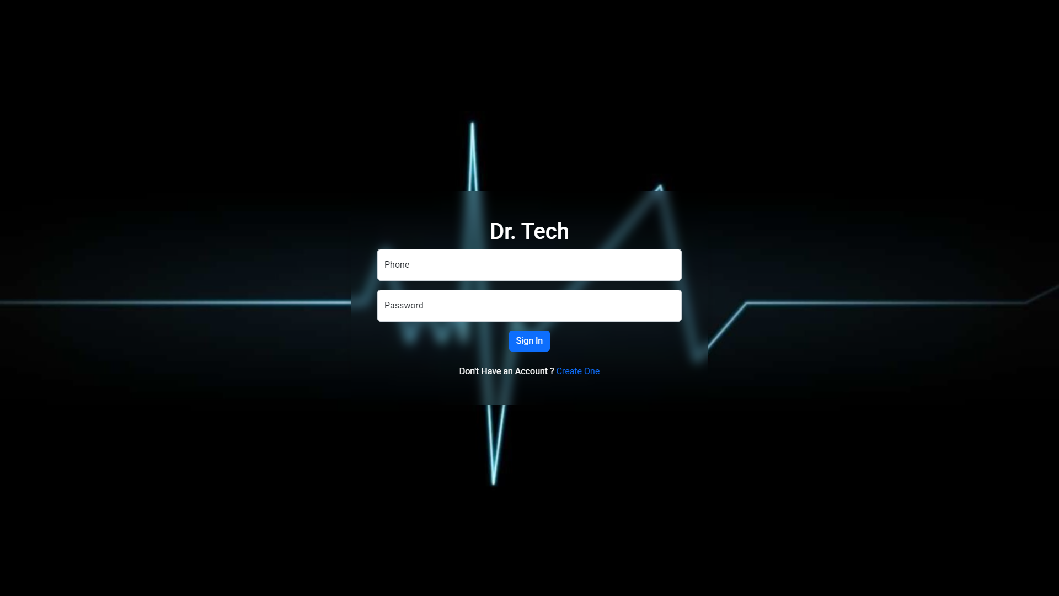
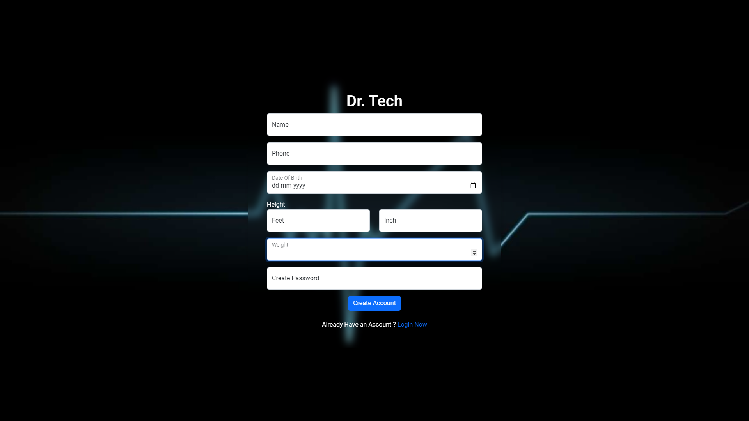
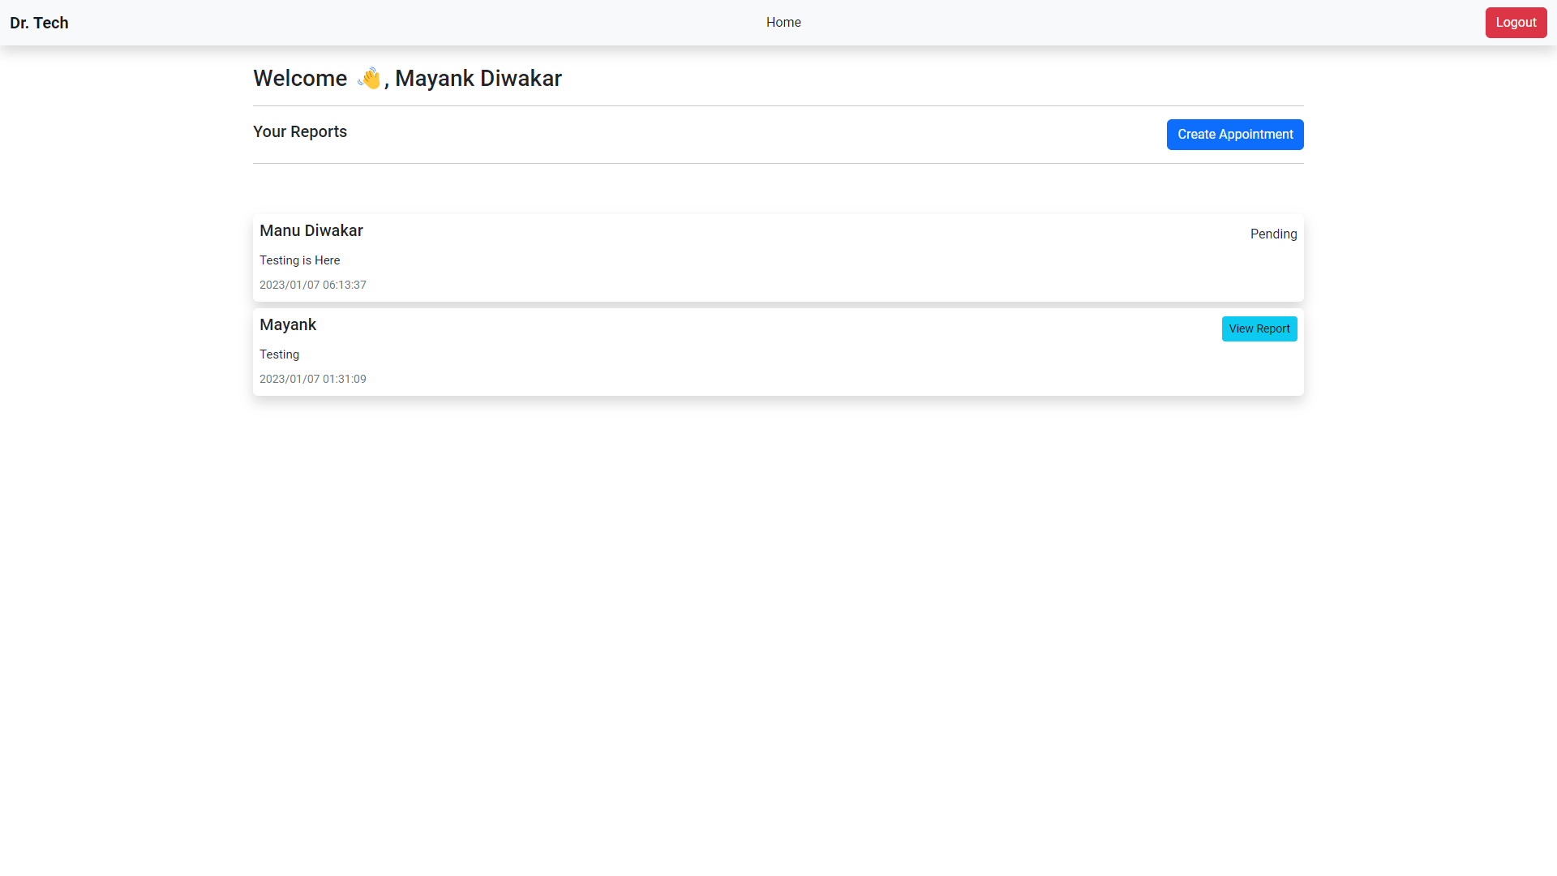
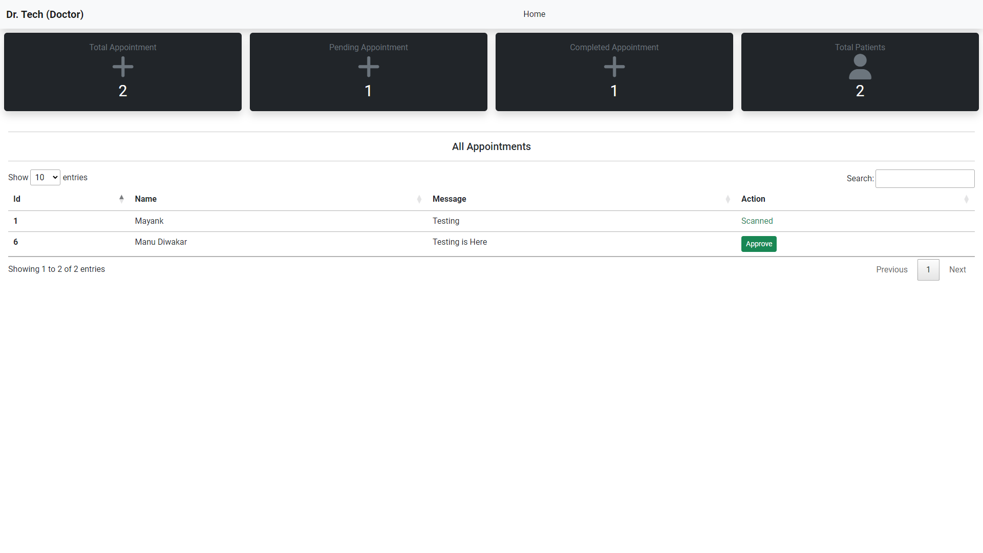
Interface
User Login Page

Slide 11
Interface
User Registration Page

Slide 12
Interface
User Dashboard

Slide 13
Interface
Doctor Dashboard

Slide 14


Applications

Slide 15
Applications
As we can witness in our own homes, there are old persons who are unable to regularly visit the hospital. With the aid of this gadget, they may record the patient's temperature and ECG.

Slide 16
Applications
People who live in rural areas without access to doctors can use our software to connect remotely with a doctor.

Slide 17
Applications
Our solution can be used for military purposes, such as enabling military personnel to digitally consult with doctors while serving in subzero temperatures.

Slide 18
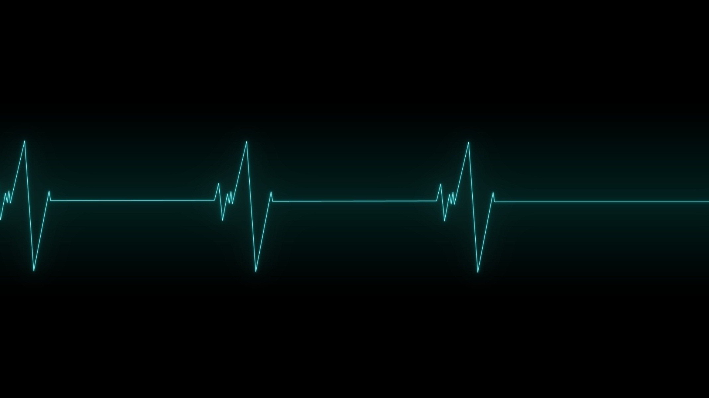

Conclusion

Slide 19
Conclusion
In conclusion, the Dr. Tech project has the potential to revolutionize the medical industry by simplifying patient care and reducing the need for in-person visits to the doctor for minor ailments.

Slide 20
Conclusion
By using advanced technology and telemedicine, the project aims to improve access to medical care and reduce the burden on the healthcare system.

Slide 21
Conclusion
If successful, Dr. Tech could greatly benefit both patients and healthcare providers, making it easier for people to receive the care they need and freeing up doctors to focus on more complex cases.

Slide 22
Conclusion
While there may be challenges and obstacles to overcome in implementing this technology, the benefits for both patients and the medical sector make it a worthy pursuit.

Slide 23


THANK YOU

